Slide 1


CAPSTONE PROJECT
E-COMMERCE REPORT ANALYSIS
Presented By
Student Name: Dishu daksh
College Name: surajmal university
Department: COMPUTER Engineering
Email ID: dishudaksh44@gmail.com

Slide 2
OUTLINE:
Problem Statement
Proposed System/Solution
System Development Approach
Algorithm & Deployment
Result (Output Image)
Conclusion
Future Scope
References

Slide 3
Problem Statement:
In the modern digital economy, e-commerce platforms generate a large amount of transactional data such as sales, profits, customer segments, product categories, and shipping details.
However, many businesses struggle to interpret this data effectively due to the lack of structured analysis tools. Traditional reporting methods often rely on spreadsheets and static reports, which fail to provide real-time insights and interactive exploration.
Because of this, organizations find it difficult to identify high-performing products, analyze regional sales performance, and understand customer behavior.
Therefore, there is a need for an interactive analytics system that can convert raw e-commerce data into meaningful business insights.

Slide 4
Proposed Solution:
To overcome the challenges of analyzing large volumes of e-commerce data, this project proposes the development of an interactive E-Commerce Sales Analytics Dashboard using Microsoft Power BI.
The main objective of the proposed system is to convert raw transactional data into meaningful and easy-to-understand visual insights that help businesses make better decisions.
The proposed solution includes the following components:
Data Collection The system uses the Sample Superstore dataset, which contains information about customer orders, sales revenue, profit margins, product categories, shipping modes, and regional sales data.
Data Preprocessing Before analysis, the dataset is cleaned and transformed using Power Query. This step removes inconsistencies, handles missing values, and prepares the data for analysis.
Data Modeling and KPI Creation Important business metrics such as Total Sales, Total Profit, Total Orders, and Total Discount are calculated using DAX (Data Analysis Expressions). These KPIs provide a quick overview of business performance.

Slide 5
Dashboard Visualization Interactive visualizations are created to present the insights clearly, including:
• Bar charts for product category performance • Line charts for sales trends • Map visualizations for regional sales distribution • Pie charts for customer segment analysis • Slicers for filtering data by region, shipping mode, and category
Interactive Analysis Users can interact with the dashboard by applying filters and slicers, allowing them to explore the data from multiple perspectives and identify patterns or trends quickly.
Overall, the proposed system provides an efficient and user-friendly solution for analyzing e-commerce data and supporting data-driven decision making.

Slide 6
System Approach:
The development of the E-Commerce Sales Analytics Dashboard follows a structured and systematic approach to ensure accurate analysis and effective visualization of data. The process involves several stages including data collection, preprocessing, modeling, and dashboard creation.
1. Data Collection
The project uses the Sample Superstore dataset, which contains detailed information about customer orders, sales revenue, profit, shipping modes, product categories, and regional distribution. This dataset serves as the primary source for analyzing e-commerce business performance.
2. Data Cleaning and Transformation
Before analysis, the dataset is processed using Power Query in Microsoft Power BI. During this stage:
• Missing values and inconsistencies are identified and corrected • Data types are standardized for accurate calculations • Columns are renamed and formatted for better readability
This step ensures that the dataset is clean, structured, and ready for analysis.
3. Data Modeling
After cleaning the data, relationships are established between different fields such as product category, region, and customer segment. Calculated measures and business metrics are created using DAX (Data Analysis Expressions).

Slide 7
Examples of key metrics include:
• Total Sales • Total Profit • Total Orders • Total Discount
These KPIs provide a clear overview of the business performance.
4. Dashboard Design and Visualization
Interactive visualizations are created to represent the data in an easy-to-understand format. Various charts and visuals are used, including:
• Bar charts to compare product categories • Line charts to analyze sales trends • Map visuals to display regional sales distribution • Pie charts to analyze customer segments
Slicers and filters are also added to allow users to interact with the dashboard and explore data dynamically.
5. Deployment and Usage
Once the dashboard is completed, it can be published to Power BI Service for cloud-based access. This allows stakeholders and decision-makers to access the dashboard from different devices and collaborate effectively.

Slide 8
Algorithm & Deployment:
Algorithm Used: Descriptive analytics was used to analyze historical sales data and identify trends.
Process:
Import dataset into Power BI
Clean and transform data using Power Query
Create calculated measures using DAX
Design dashboard visuals and KPIs
Apply filters and slicers for interactive analysis
Deployment: The dashboard can be published to Power BI Service, enabling cloud access and collaboration.

Slide 9
Result:
This slide should include a screenshot of your dashboard.
Explain:
• KPI cards show total sales, profit, orders, and discounts • Sales by category highlights top-performing product groups • Sub-category chart identifies best-selling products • Map visualization shows regional sales distribution • Pie chart displays customer segment contribution
The dashboard enables quick and effective business analysis.
FINAL PROJECT LINK : https://github.com/dishu-13/E-Commerce-Sales-PowerBI-Dashboard.git

Slide 10
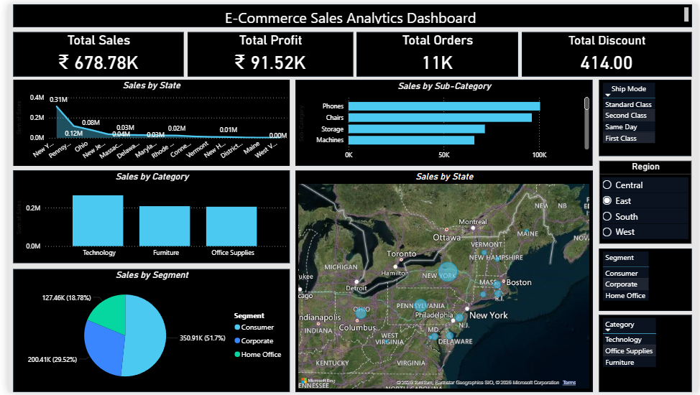
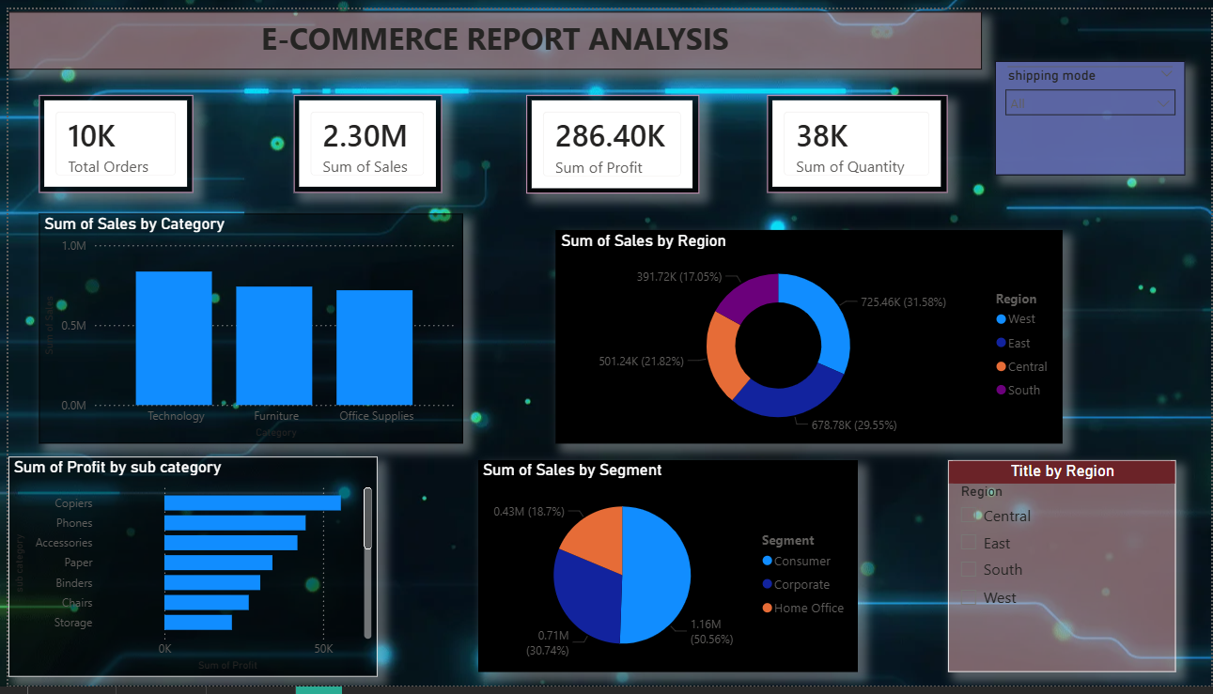
RESULT
RESULT

Slide 11
Conclusion:
The E-Commerce Sales Analytics Dashboard demonstrates how data visualization and business intelligence tools can transform raw data into valuable insights.
Through the use of Microsoft Power BI, the project successfully integrates sales, profit, customer segments, and regional data into a single interactive dashboard. This enables users to easily monitor key business metrics and analyze trends.
The dashboard helps identify:
• The most profitable product categories • The top-performing regions in terms of sales • Customer segments that contribute the most revenue • The impact of discounts and shipping modes on overall performance
By presenting these insights in a visual and interactive format, the system allows decision-makers to quickly understand business performance and make informed strategic decisions.
Furthermore, the project highlights the importance of data visualization, interactive dashboards, and business intelligence tools in modern data-driven organizations.
In conclusion, the developed dashboard not only simplifies complex data analysis but also provides a powerful platform for monitoring and improving e-commerce business performance.

Slide 12
Future scope:
1. Integration of Real-Time Data
The dashboard can be integrated with real-time data sources such as online transaction databases or APIs. This will allow businesses to monitor sales performance instantly and respond quickly to market changes.
2. Predictive Analytics
Machine learning algorithms can be integrated to forecast future sales trends. Techniques such as regression analysis, time-series forecasting, or AI models can help businesses predict demand and plan inventory more effectively.
3. Advanced Customer Analysis
Future versions of the system can include deeper customer analytics, such as customer lifetime value, purchasing behavior patterns, and personalized recommendation systems.
4. Multi-Region and Global Analysis
The dashboard can be expanded to include data from multiple countries or regions, allowing businesses to perform global performance comparisons and market expansion analysis.
5. Integration with Cloud Platforms
The system can be deployed using Azure Cloud or Power BI Service, enabling secure sharing, scalability, and accessibility across multiple devices.

Slide 13
References:
• Microsoft Power BI Documentation • Data Visualization & Business Intelligence Resources • Sample Superstore Dataset • Power BI Community Tutorials
Dataset: SampleSuperstore.csv.xlsx
Github link : https://github.com/dishu-13/E-Commerce-Sales-PowerBI-Dashboard.git

Slide 14
Thank You

